Slide 1
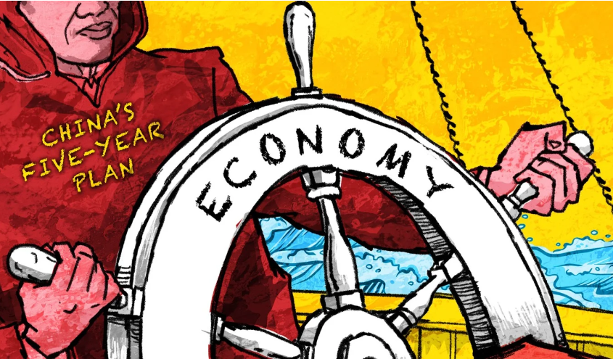
China‘s 15th 5-year plan: A Belgian sectoral reading
Date: April 23, 2026
Speaker: Dorien Emmers

Slide 2
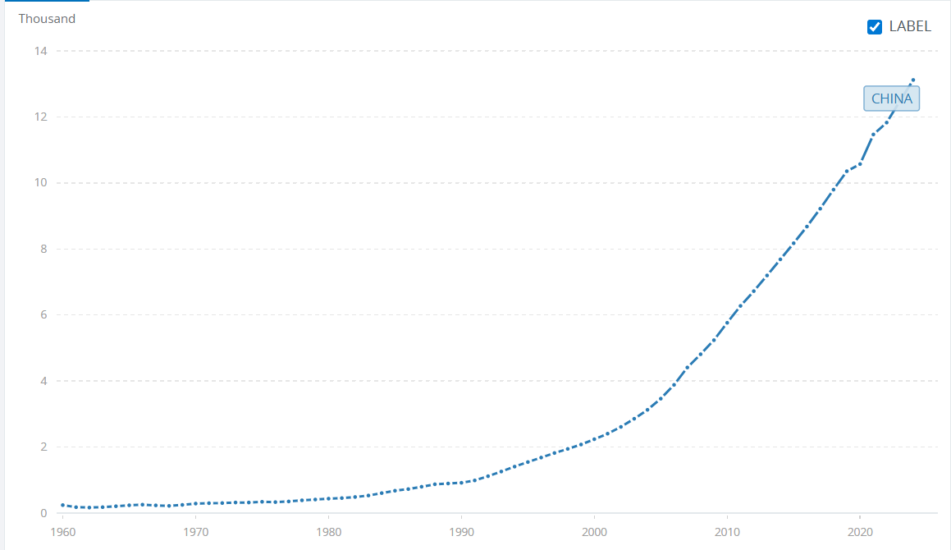
Is the Chinese economy a ticking timebomb?
GDP per capita (in constant 2015 USD)
Lower projections for growth:
2026: growth of 4.5-5%
Following years: expected growth of 4.5%
NOTE: China is already the 2nd largest economy (since 2010).
The Chinese economy is not likely to implode, but growth rates will be lower and there are many stumbling blocks ahead.
Source: World Bank Data.

Slide 3
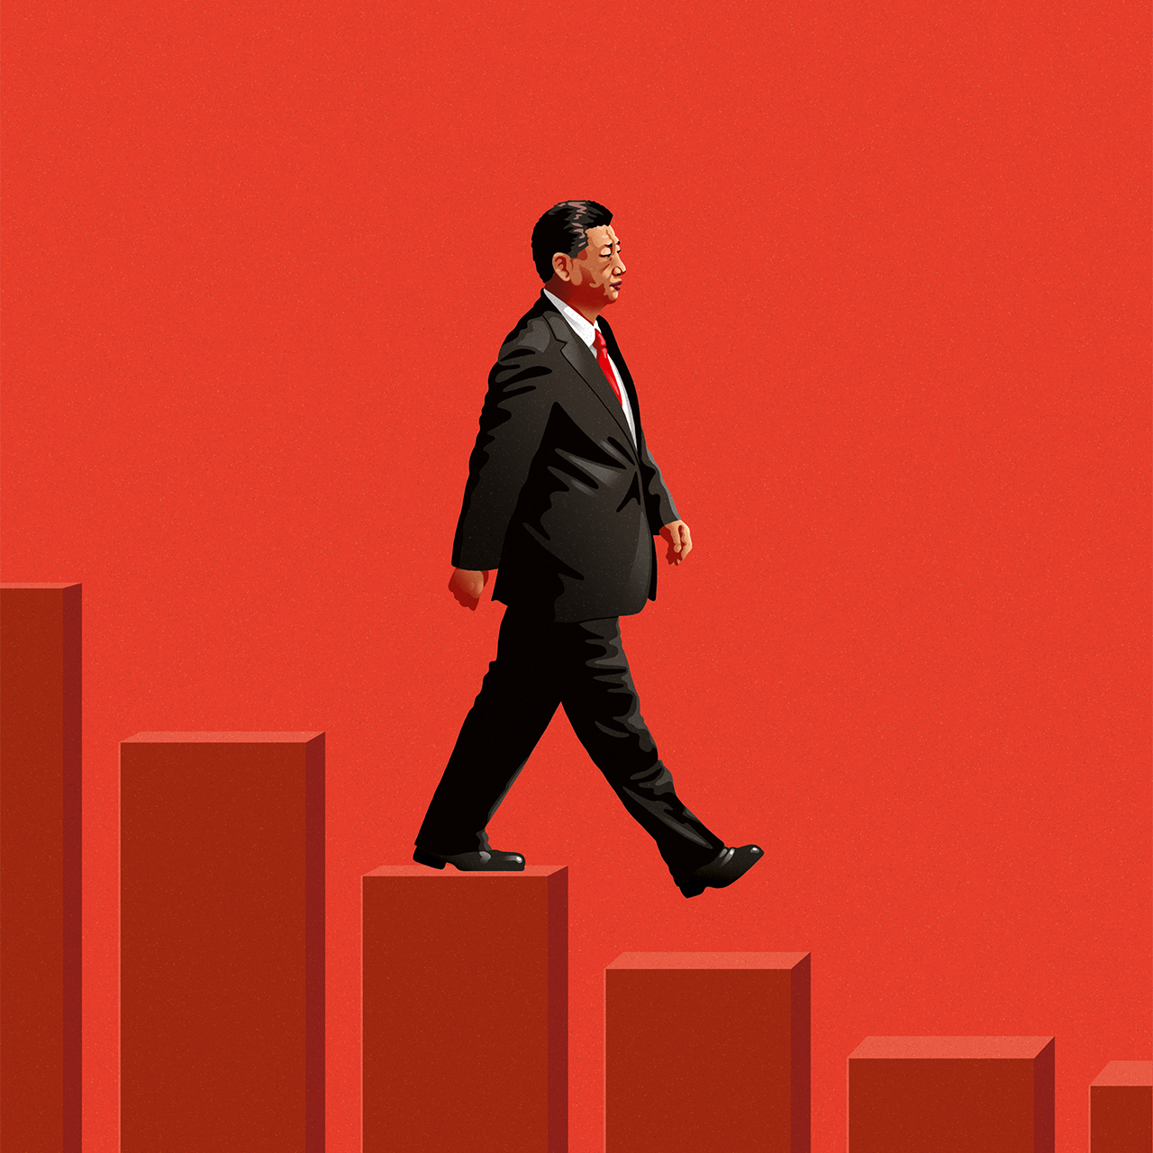
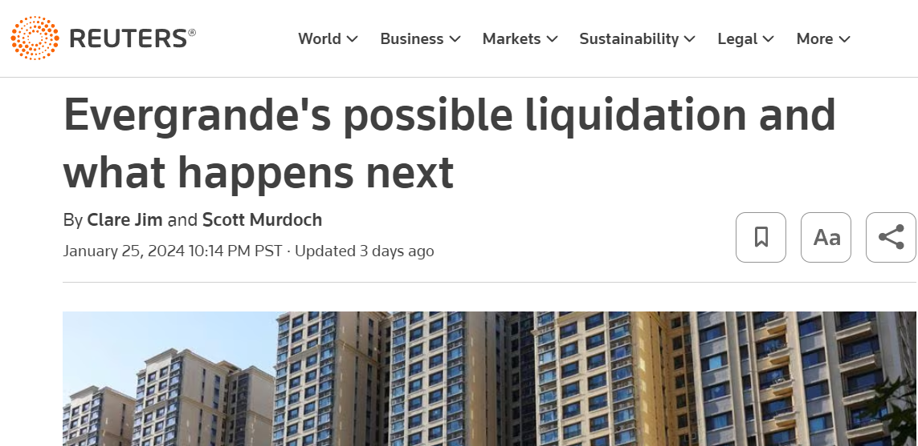
Challenges
Geopolitics
➔ Focus on autonomy and self-reliance
Loss of demographic dividend
➔ Invest in talent dividend
Imbalanced growth
Need of rebalancing? (Boost domestic consumption)
Notes:
Arthur Kroeber of Dragonomics
Resources used for public investment cannot be allocated elsewhere. This supresses consumption of households.

Slide 4
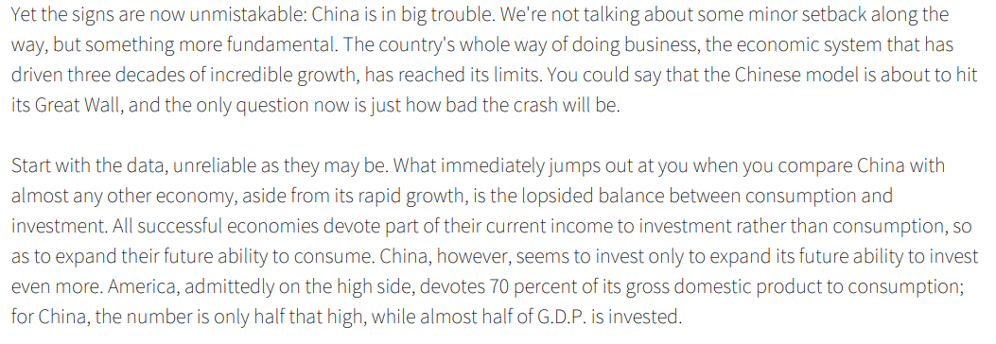
Imbalanced growth
Paul Krugman (18 juli 2013, The New York Times):
Notes:
Export + industrial manufacturing

Slide 5
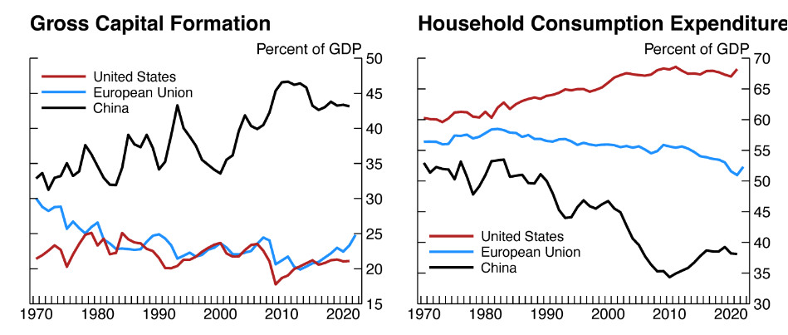
Imbalanced growth
➔ Time to boost domestic household consumption?

Slide 6
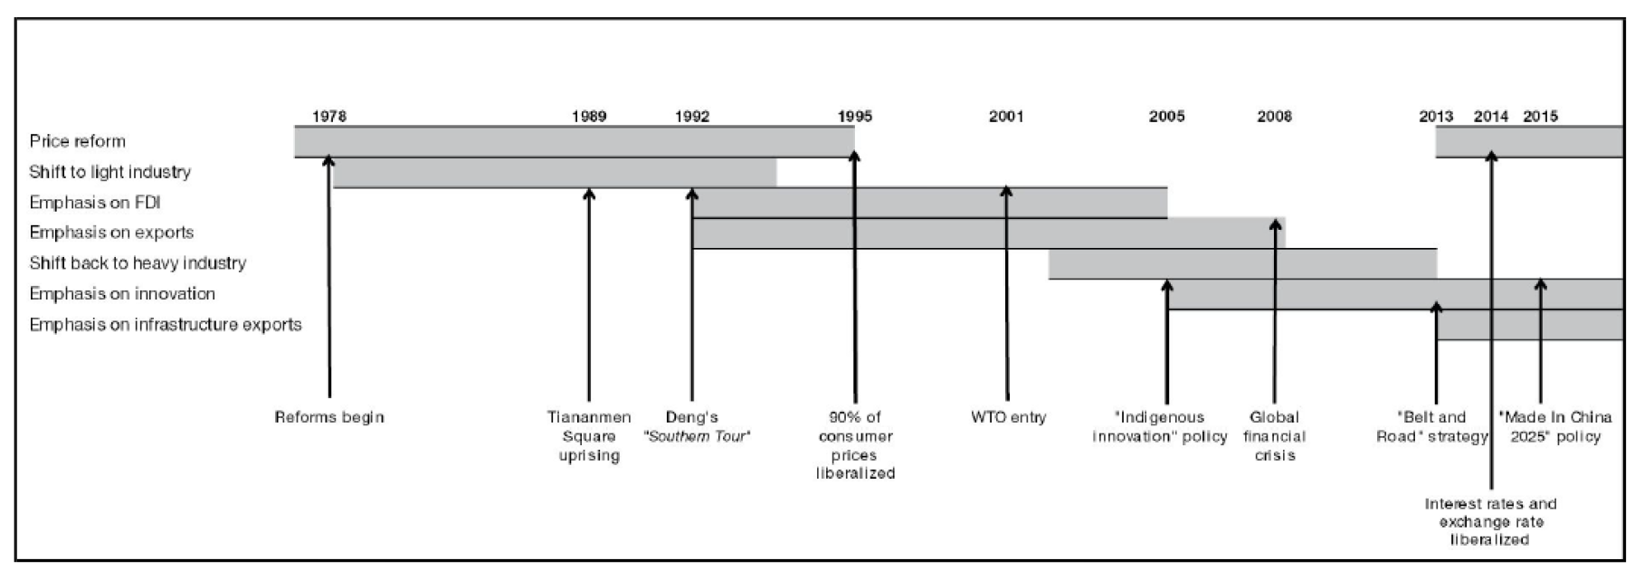
China’s industrial policy since 1978
2003/4-2012/13: Fourth generation of leaders (under Hu Jintao and Wen Jiabao)

Slide 7
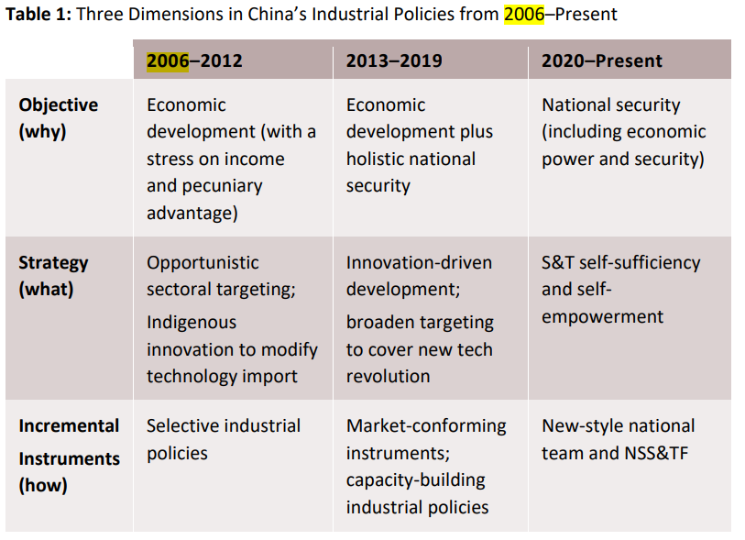
Industrial policy: Focus on innovation and technology (since 2006)
Relatively “aggressive” industrial policy
2006: “Indigenous innovation” (自主创新, Zìzhǔ chuàngxīn)
Note: Strong focus on self-sufficiency/autonomy.
Introduced in the Medium- and Long-Term Plan for Science and Technology Development (国家中长期科学和技术发展规划纲要) published in December 2005.

Slide 8
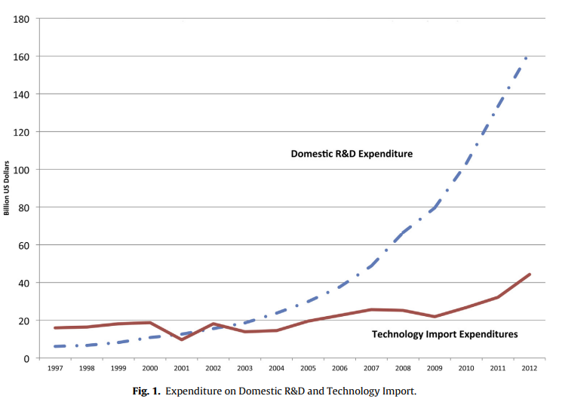
Industrial policy: Investment in R&D
Self-sufficiency/autonomy in technological development
Increase in R&D expenditure.
Reduction in import of foreign technology.
15th 5-year plan announces 7% increase per year in R&D investments.

Slide 9
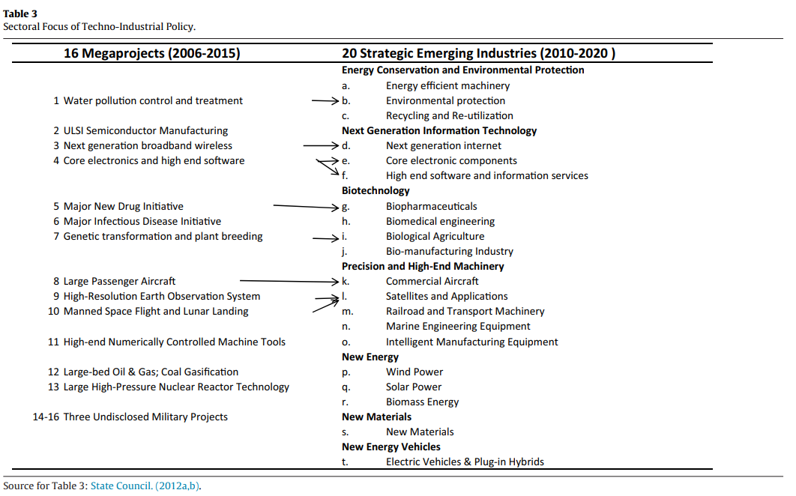
Industrial policy: “Strategic Emerging Industries”
➔ Investment in strategic emerging industries.

Slide 10
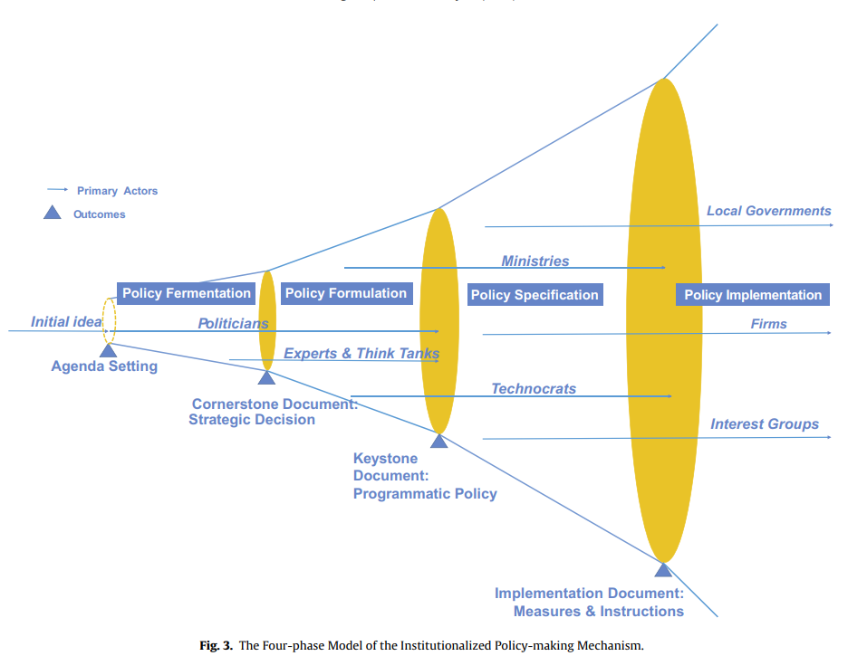
Industrial policy: From central to local
Centralized agenda setting
More decentralized implementation
Source: Chen, L., & Naughton, B. (2016). An institutionalized policy-making mechanism: China’s return to techno-industrial policy. Research Policy, 45(10), 2138-2152.

Slide 11
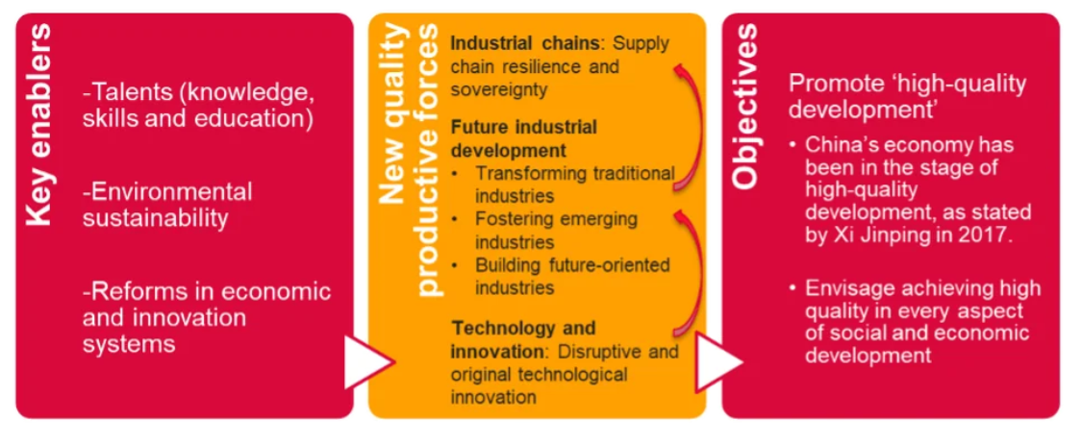
Since 2023: “New Quality Productive Forces”
Source: Cambridge Industrial Innovation Policy (CIIP).

Slide 12
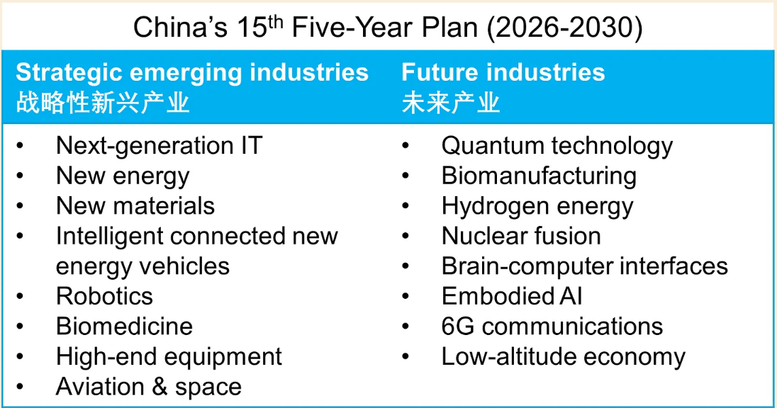
15th 5-year plan
Source: Kyle Chan’s High Capacity substack.

Slide 13
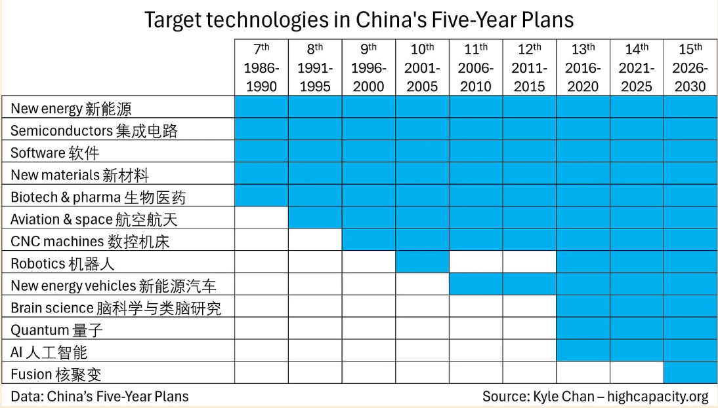
15th 5-year plan
Notes:
quantum, fusion, brain-computer interface, drones and flying cars, and AI.
China is aiming to develop “strategic emerging industries” (战略性新兴产业) such as robotics and smart EVs as well as “future industries” (未来产业) such as quantum, fusion, brain-computer interfaces, 6G, and embodied AI.

Slide 14
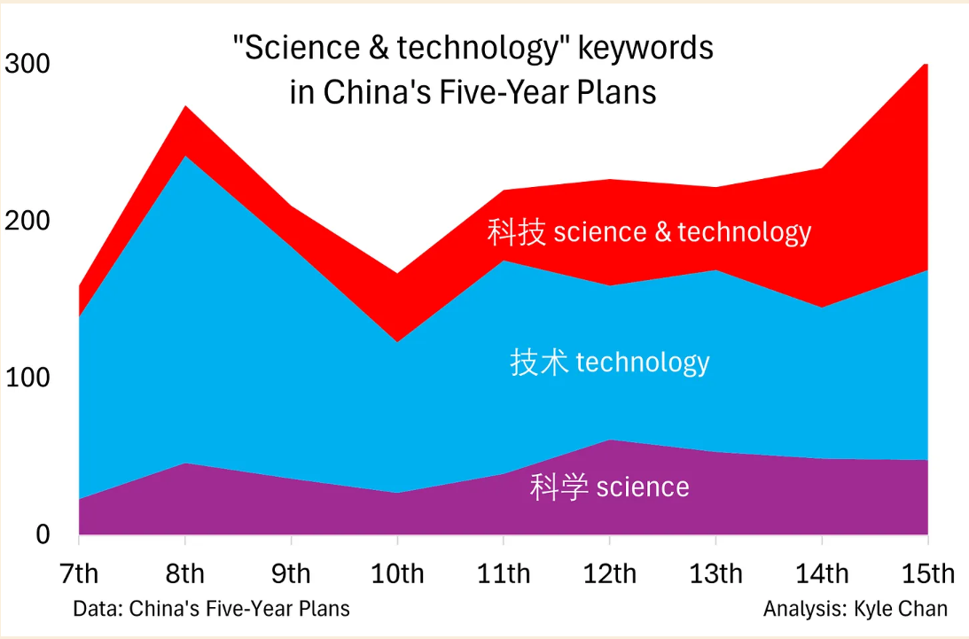
15th 5-year plan

Slide 15
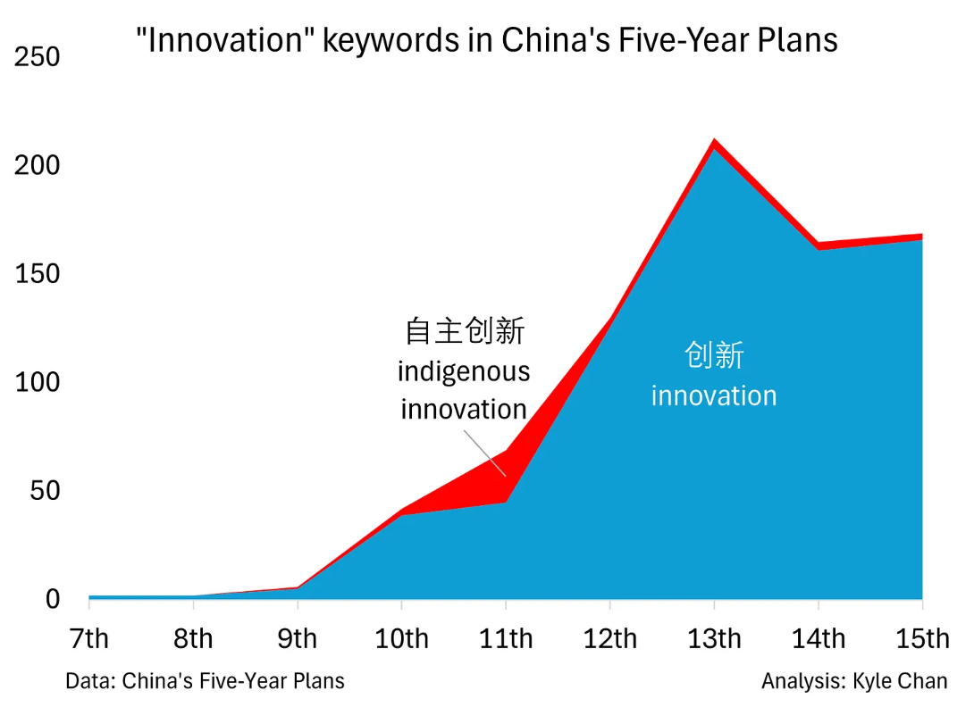
15th 5-year plan
Notes:
Nadruk op autonome innovatie

Slide 16
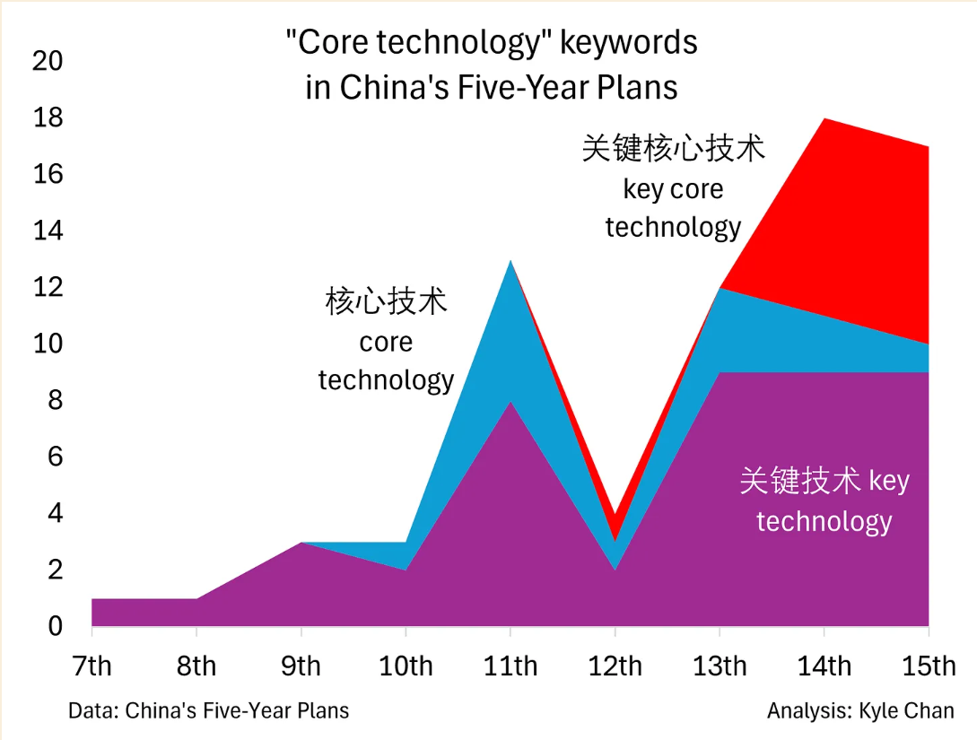
15th 5-year plan
Notes:
Nadruk op chokepoints vermijden

Slide 17
How to continue industrial policy & boost domestic consumption at the same time??

Slide 18
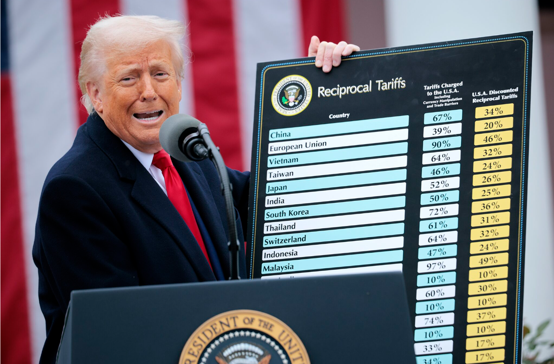
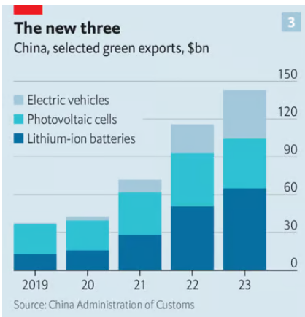
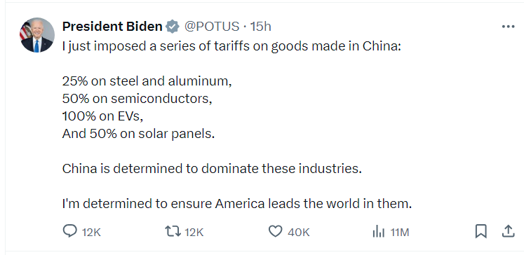
Consequences for the West
(Over)production of green technologies.
Counteract with protectionist measures/subsidies/…?

Slide 19
Risks, but also opportunities for Belgian companies
Industries that are not listed as an emerging/future industry, are likely to encounter less competition and restrictions. They may benefit from enhanced domestic consumption in China (which is also a key objective in the new five-year plan).
For example: High-value food products.
Industries listed as emerging/future industries, they should expect increased competition during the following years. We might also be able to learn from China.
For example: EV’s, pharmaceutical and chemical industry.

Slide 20
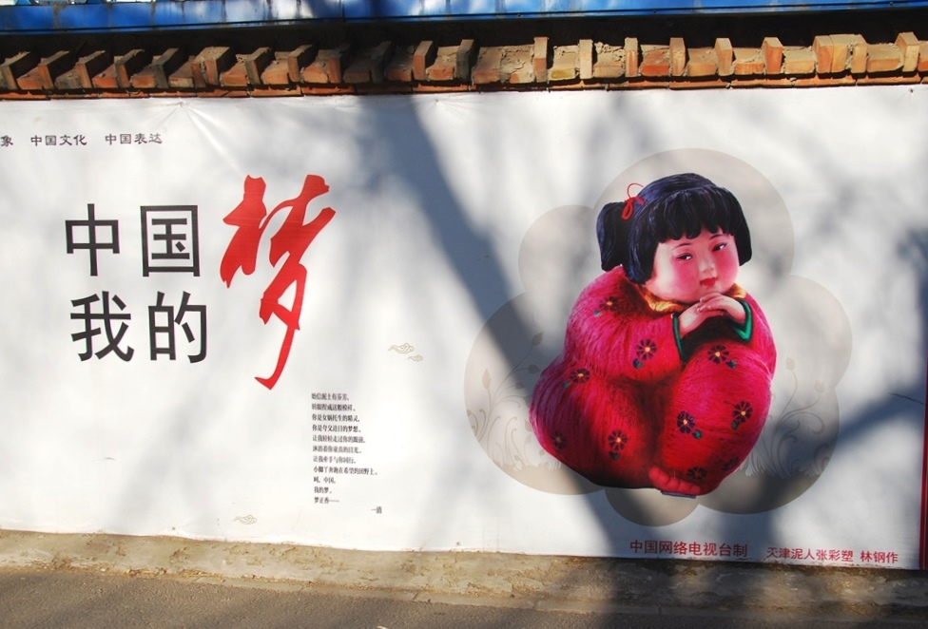
What does China want?
Chinese Dream (vs. American Dream):
Focus on common prosperity (gongtong fuyu, 共同富裕) rather than individual prosperity.
A dream of national rejuvenation (zhonghua minzu weida fuxing, 中华民族伟大复兴), emphasizing a harmonious society, self-reliance, and a strong sense of historical consciousness.

Slide 21
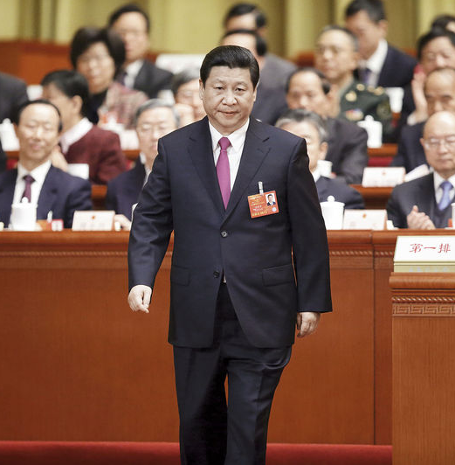
What does China want?
“Grote Rejuvenation of the Chinese Nation”
“Two Centenary Goals”:
By 2021 (100 years of the CCP): to become a “moderately prosperous society” （全面建成小康社会).
Dream of material well-being: For example, Xi promises to double China’s GDP by 2035.
By 2049 (100 years of the PRC): to become a fully developed nation that is prosperous, powerful, democratic, culturally advanced, harmonious, socialist, and modernized （建成富强、民主、文明、和谐的社会主义现代化国家).
Dream of modernization.
“Dare to dream, work diligently to realize your dreams, and contribute to the rejuvenation of the nation.”
What China wants? A stable environment to pursue this goal.
Notes:
JZM: entrepreneurs
HJT/WJB: herverdeling
XJP: middenklasse

Slide 22
Can we copy-paste China’s industrial policy model?
Expensive and wasteful
Requires a large scale

Slide 23
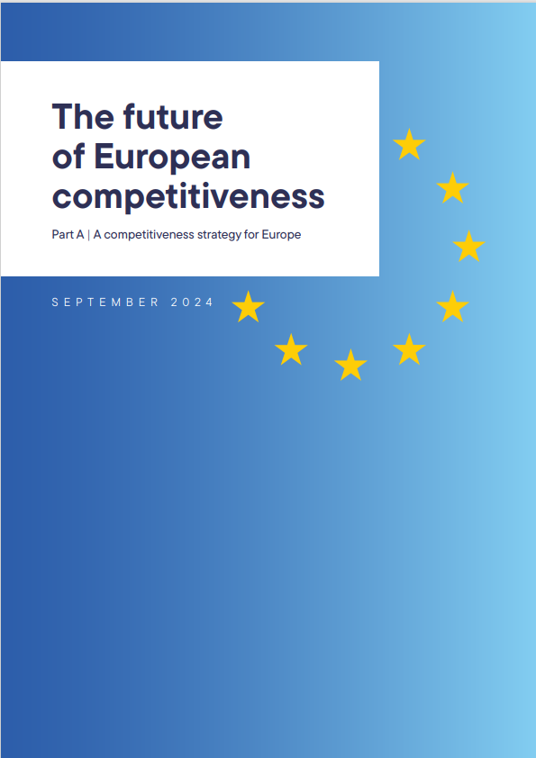
Only 4 out of 5 leading tech companies are located in Europe.
Invest in science and technology.
Deep capital markets to keep start-ups in Europe.
Energy prices in the EU are 2-5 times higher than in the US or China.
Invest in (renewable) energy
Need of EU-level coordination.

Slide 24
Thank you!

