Slide 1








建设世界领先科技园区
打造金融科技发展高地
Building a World-Leading Technology Park and Creating a Hub for Fintech Development

Slide 2
0
1
中关村西城园
Basic Information of Xicheng Park

Slide 3

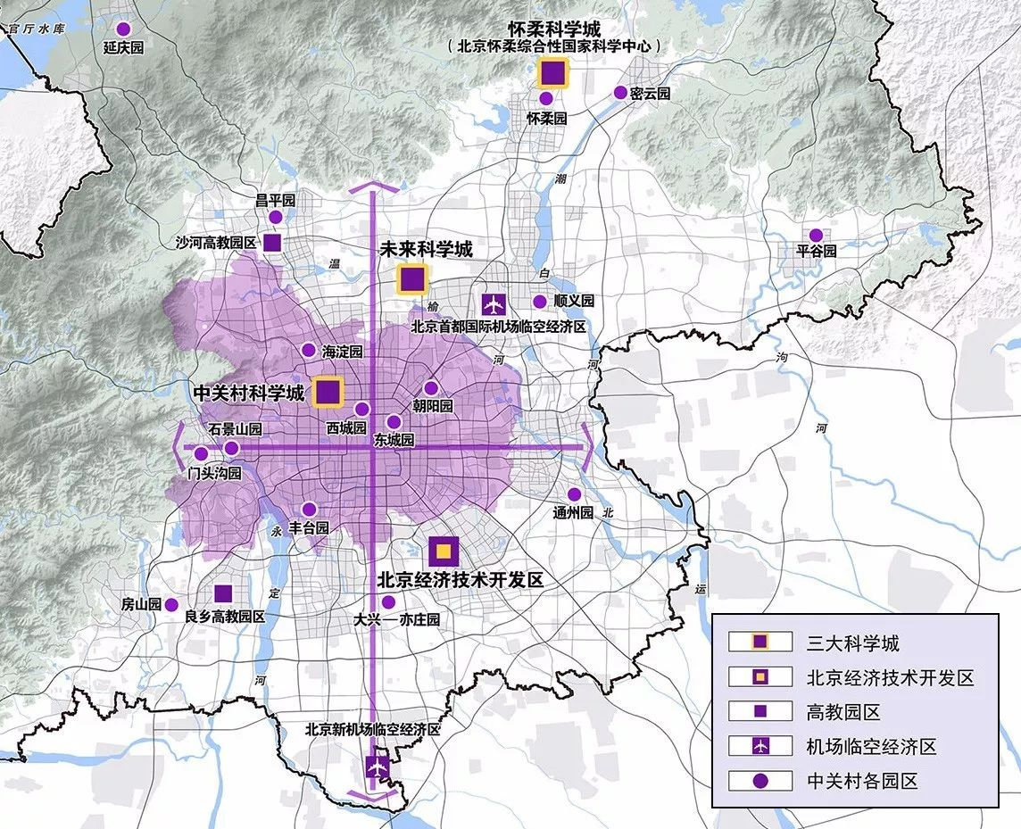
中关村西城园是中关村国家自主创新示范区“一区十六园”之一
The Xicheng Park of Zhongguancun Science Park is one of the "One Zone and Sixteen Parks" in the Zhongguancun National Independent Innovation Demonstration Zone
全区科技服务业总收入排名全市第二
The district ranks second in total income from the technology service sector in Beijing.
地均产出率排名全市第二
Its per-area output is also second among all districts.

Slide 4

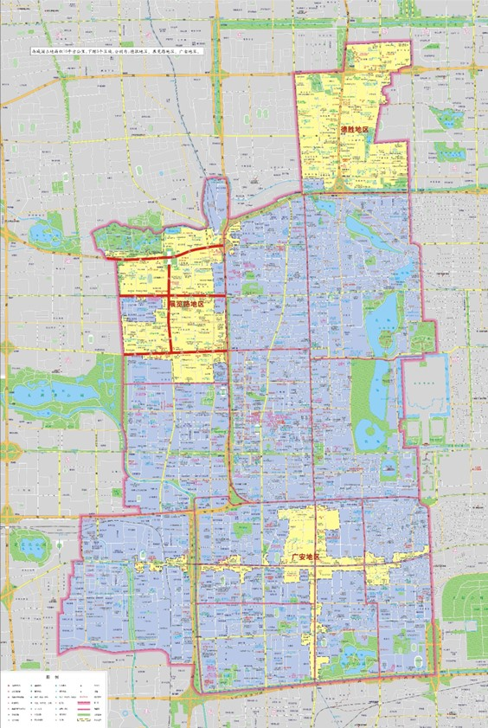
园区总体情况
Overall Situation of the Park
“1+3”产业
国家级金融科技示范区
National Fintech Demonstration Zone
德胜
DeSheng
“1+3”Industries
国家级文化和科技融合示范基地
National Demonstration Base for the Integration of Culture and Technology
金融科技
Fintech
北展
BeiZhan
中国北京出版创意产业园区
China Beijing Publishing Creative Industry Park
数字经济
Digital Economy
北京“设计之都”核心区
The core area of the "design capital" of Beijing
广安
GuangAn
研发设计
R&D and Design
11家科技企业孵化机构
Incubators for 11 technology companies
文化科技
Culture and Technology
政策区范围10平方公里
The area covered by the policy is 10 km²

Slide 5
为企提供
全生命周期服务
Full Life Cycle Services for Businesses
选址踏勘 Site survey
合作交流
Cooperation and exchange
装修协调
Decoration and coordination
品牌建设
Brand building
登记注册
Registration
北京
服务
Beijing
Service
全周期
Full Lifecycle
早期
Early stage
专业服务
Professional Services
惠企政策
Policies benefiting enterprises
人才服务
Talent services
战略入股
Strategic investment
上市培育
Preparation for IPO
中期
Middle stage

Slide 6
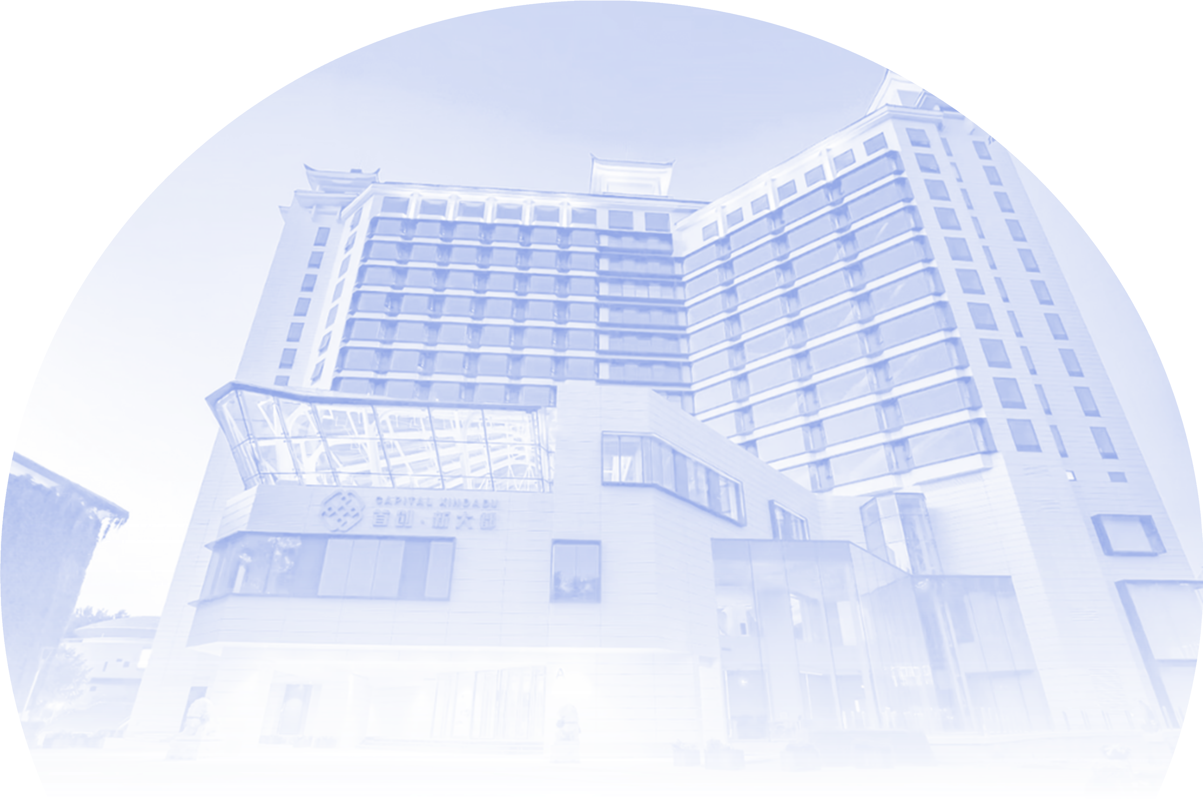
优化升级产业政策
Optimize and upgrade industrial policies
科创十条
科创十二条
Measures of Beijing’s Xicheng District to Promote Scientific and Technological Innovation and the High-Quality Development of the Xicheng Park of Zhongguancun Science Park
Ten Measures on
Advancing Technological
and Scientific Innovation
优化升级
Upgrade
1.科技创新类，主要围绕企业科技创新行为开展支持；
1.Technological Innovation: Focus on facilitating enterprises’ technological innovation.
2.发展要素类，主要围绕科技金融、孵化培育、空间载体、人才等方面开展支持；
2.Development Factors: Provide support for science, technology, finance, incubation, infrastructure, and talent cultivation.
3.行业支持类，主要支持科技服务业和金融科技产业。
3. Industry Support: Focus on supporting the science and technology service sector and the fin-tech industry.
金科十条2.0
Several Measures to Support the Construction of Beijing Financial Science and Technology and Professional Service Innovation Demonstration Zone (Xicheng Area) 2.0

Slide 7
0
2
国家级金融科技示范区
Construction of the New State-Level Jinke New Area

Slide 8
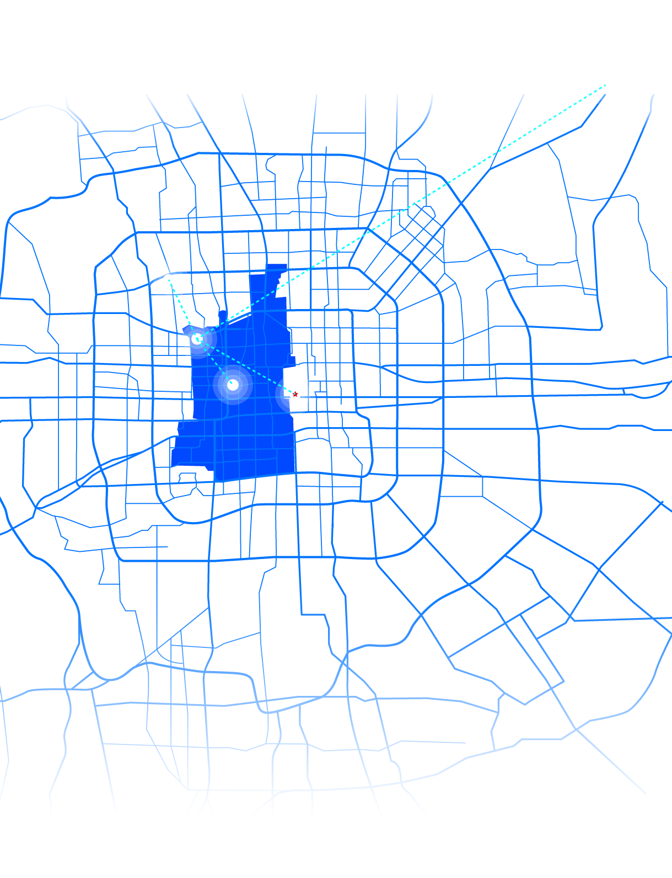
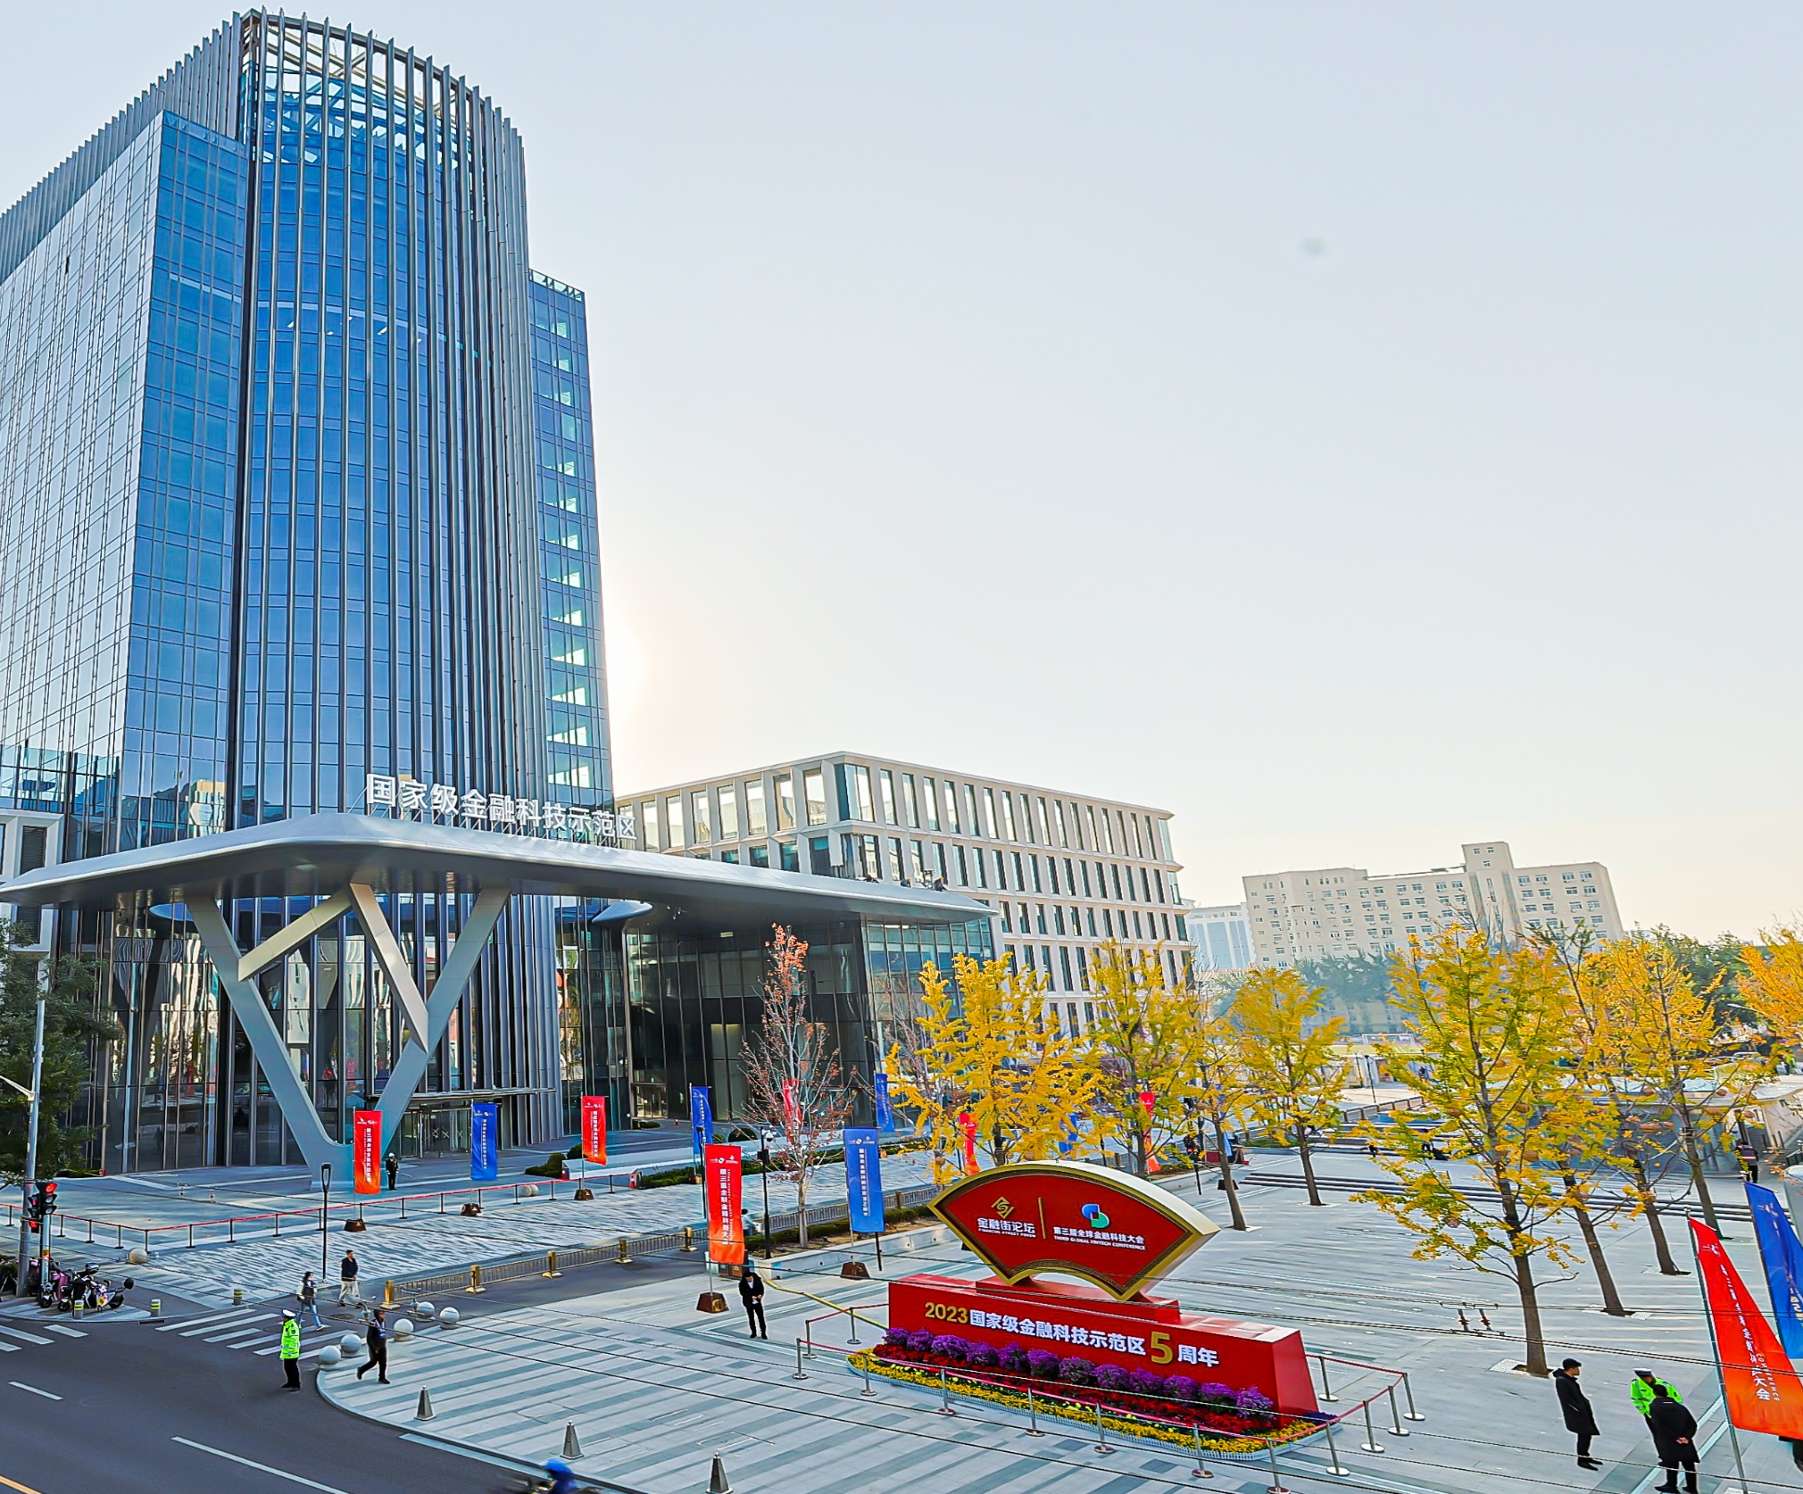
首都国际机场
Beijing Capital International Airport
中关村
Zhongguancun
唯一一个被国务院确定的国家级金融科技示范区
The only national fintech demonstration zone identified by the State Council
金科新区
Fin-Tech New Area
金融街
Financial Street
天安门
Tian’anmen
金科新区至金融街直线距离2公里
2 kilometers, as the crow flies, from the Fin-Tech New Area to the Financial Street.
金科新区至中关村直线距离5公里
5 kilometers, as the crow flies, from the Fin-Tech New Area to the Zhongguancun.
金科新区至天安门直线距离6公里
5 kilometers, as the crow flies, from the Fin-Tech New Area to the Tian’anmen.
金科新区至首都国际机场直线距离21公里
21kilometers, as the crow flies, from the Fin-Tech New Area to the Beijing Capital International Airport.

Slide 9
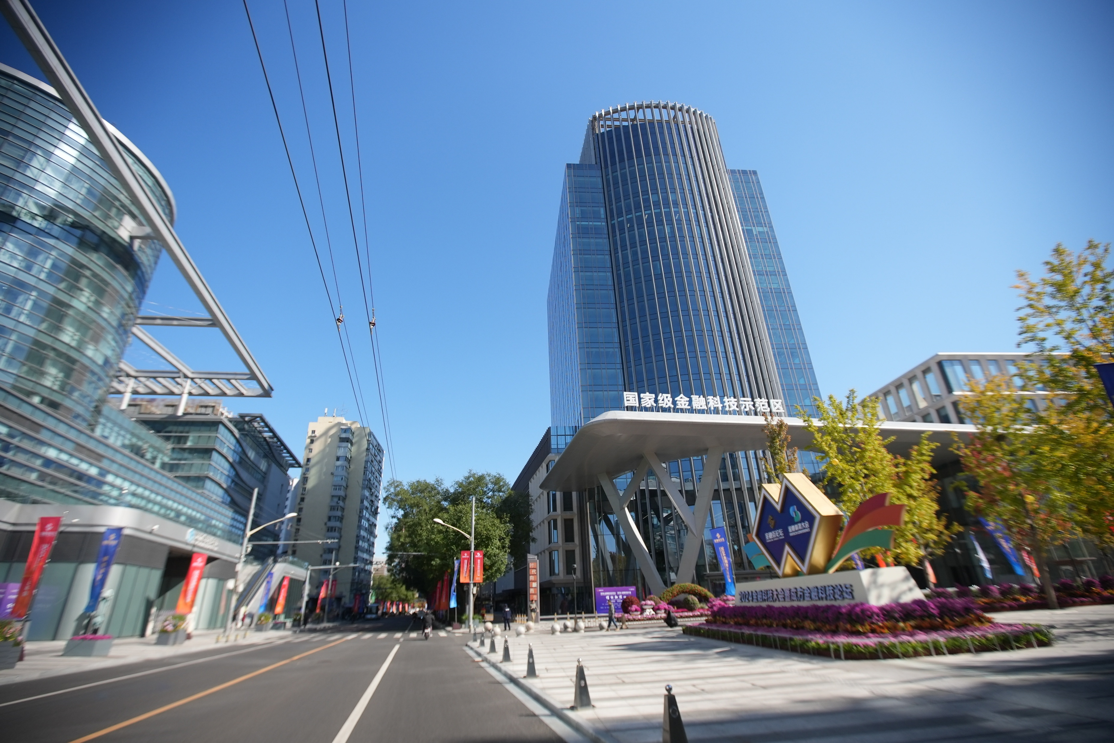
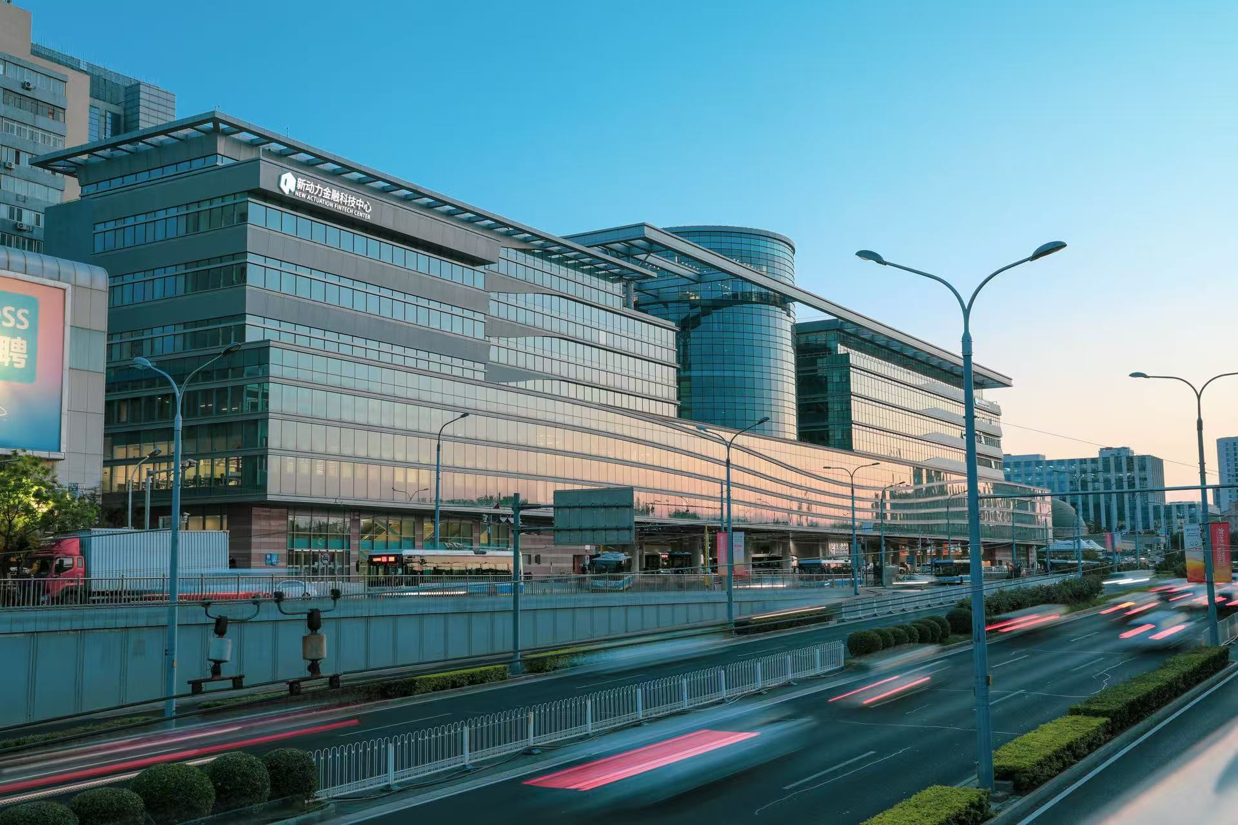
打造“国家级金融科技示范区+特色产业园+孵化平台+特色楼宇”
的金融科技产业走廊
Create a fin-tech corridor integrating a national fin-tech demonstration zone, specialized industrial parks, incubation platforms, and signature buildings

Slide 10













已引入重点金融科技和专业服务机构266家
266 major fintech and professional service agencies have been brought in
注册资本金超1400亿元
Registered capital over RMB 140 billion
中证
信息技术
国网区块链
成方金科
爱保科技
网神网络科技
工银科技
（北京）
成方金信
云成金服
神州数科
中移金科
国家金融科技认证中心
云链金汇
云粒智慧
国家金融
标准研究院
建信金服
天翼电商
国网区块链

Slide 11
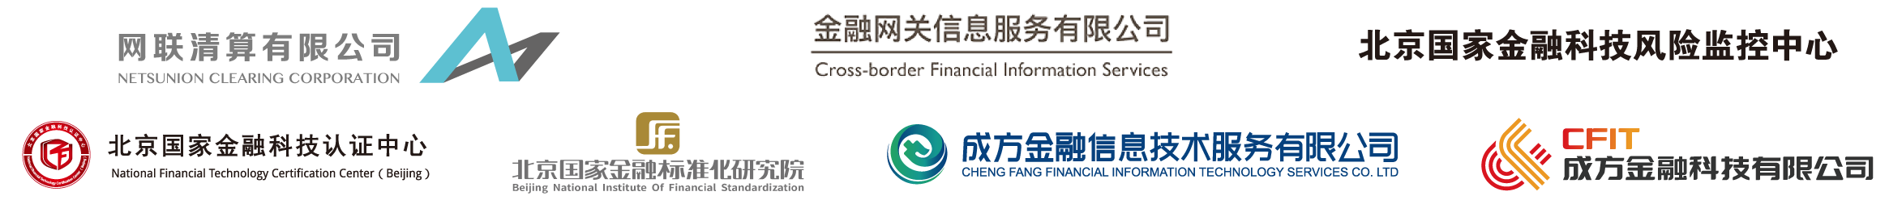




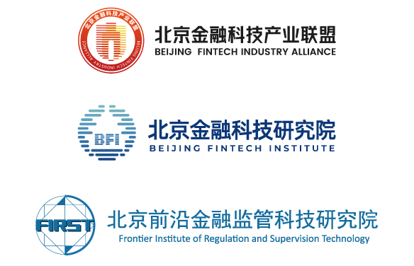

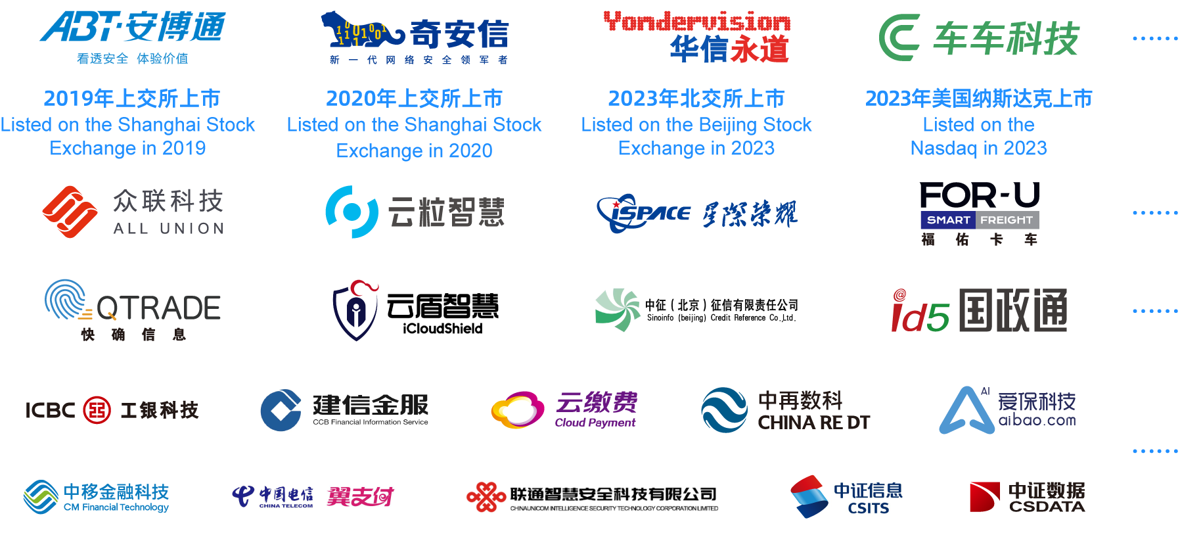
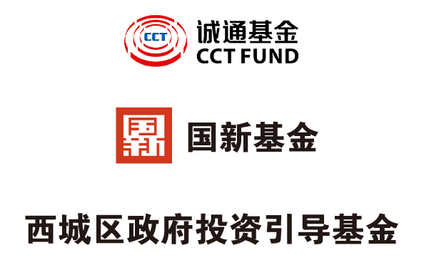
产业生态 Industrial ecosystem
金融科技基础设施 Fintech infrastructure
创新平台 Innovation platform
龙头企业 Leading enterprise
专业智库 Specialized think tank
国际化企业
International enterprise
金融网关公司
上市企业
Listed company
小巨人/独角兽
Little giant / unicorn
产业基金 Industrial fund
专精特新
Specialized, refined,
differentiated, and innovative
重点企业
Key enterprise

Slide 12
金融科技创新监管试点
Financial Technology Innovation Supervision Pilot
服务北京率先实施金融科技创新监管工具，开展资本市场金融科技创新监管试点，服务人行等六部委在北京开展金融科技应用试点，金科新区项目位居全国同类型区域之首。
Beijing is supported to take the lead in implementing the financial technology innovation supervision tool, initiate the pilot of financial technology innovation supervision in the capital market, and facilitate the financial technology application pilot conducted by the People’s Bank of China and five other ministries. The Fintech New Area project ranks first among similar zones nationwide.
40%
61%
50%
金融科技
应用试点
金融科技创新监管工具Financial Technology Innovation Supervision Tool
资本市场金融科技创新监管试点
Capital Market Financial Technology Innovation Supervision Pilot
金科新区项目
Fin-Tech New Area Project
全市所有项目
All Projects in Beijing

Slide 13





打造营商环境6.0新标杆
Business Environment Optimization 6.0 Policy Series
Market Environment
Legal Environment
企业开办快捷便利
Facilitate fast and convenient business establishment
市场主体“准入即准营”
“Access equals operation” for market entities
市场竞争公平有序
Ensure fair and orderly market competition
1
2
一体化综合监管
Implement integrated and effective supervision and regulation
公正文明执法
Strict, standardized, fair, and courteous law enforcement
知识产权保护
Intellectual property protection and promotion
多元司法解纷
Judicial efficiency and diversified dispute resolution
着力优化
营商环境
推出135项
改革任务
Investment Environment
3
4
金融要素支撑
Financial element support
推进“两区”建设
Advance development of the “Two Zones”
推进国际消费中心城市示范区建设
Promote the development of the demonstration zone of international consumption center cities
创新人才服务
Innovate talent services
企业服务精准化
Targeted enterprise services
Administrative Environment
政务服务便捷化
Advance convenient government services
政务服务集成化
Promote integrated government services
政务服务标准化
Standardize government services
政务服务信息化
Digitalize government services

Slide 14
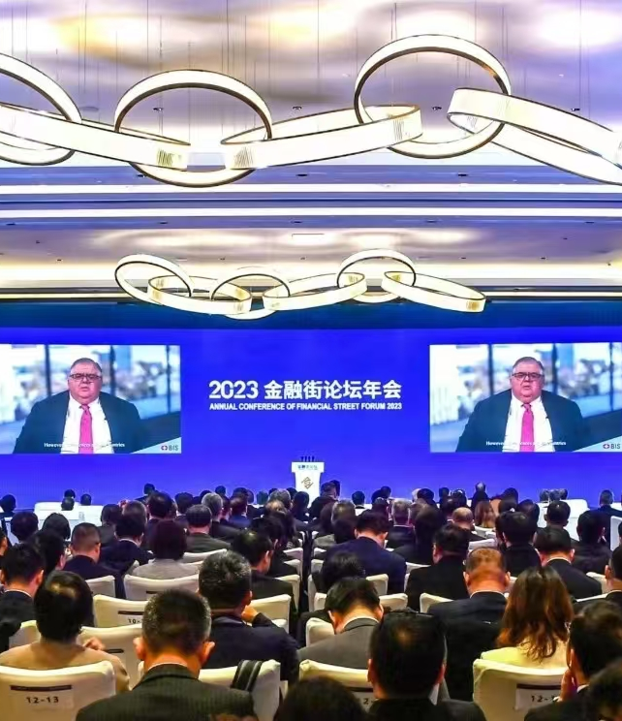
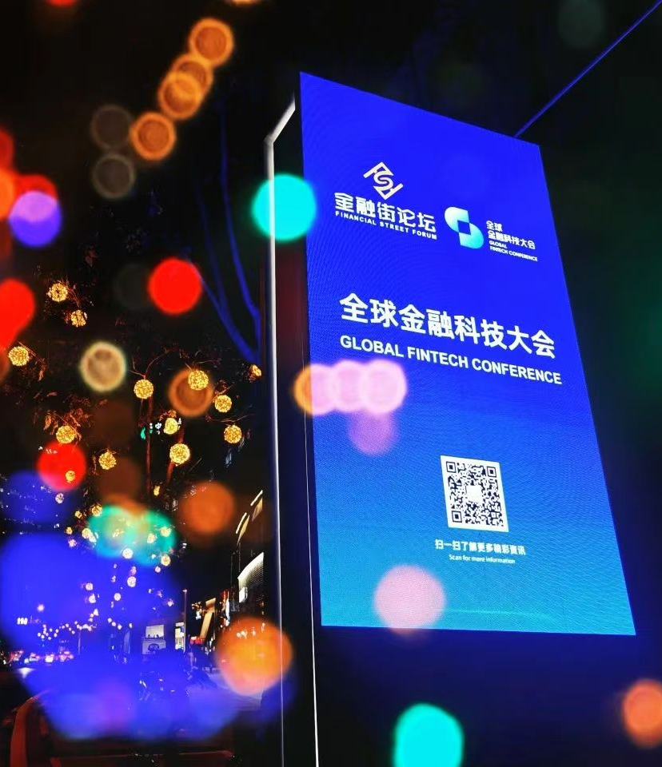
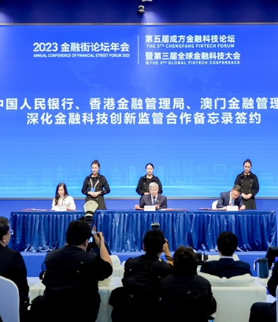
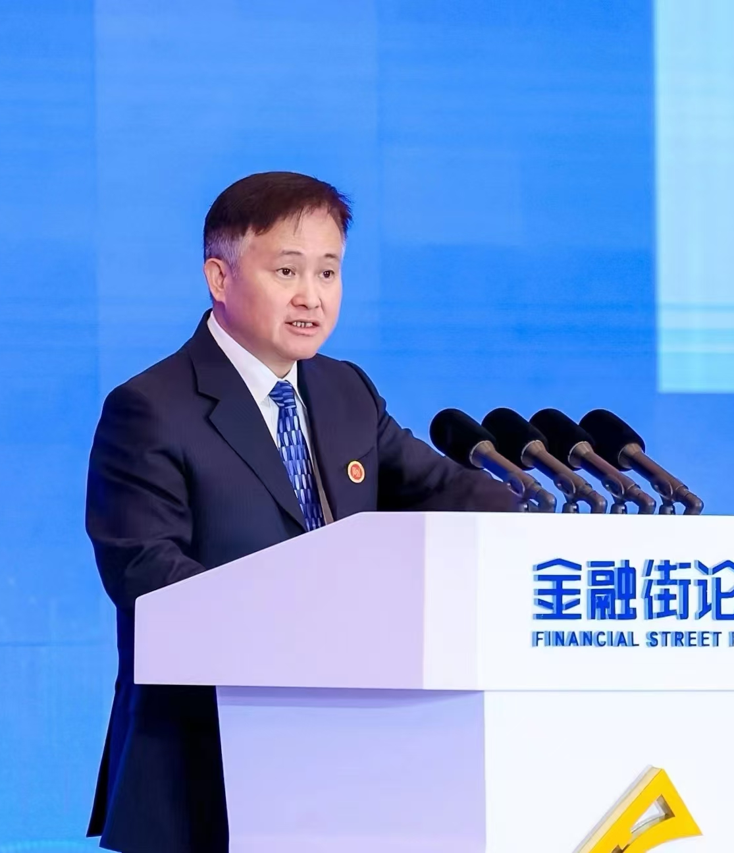
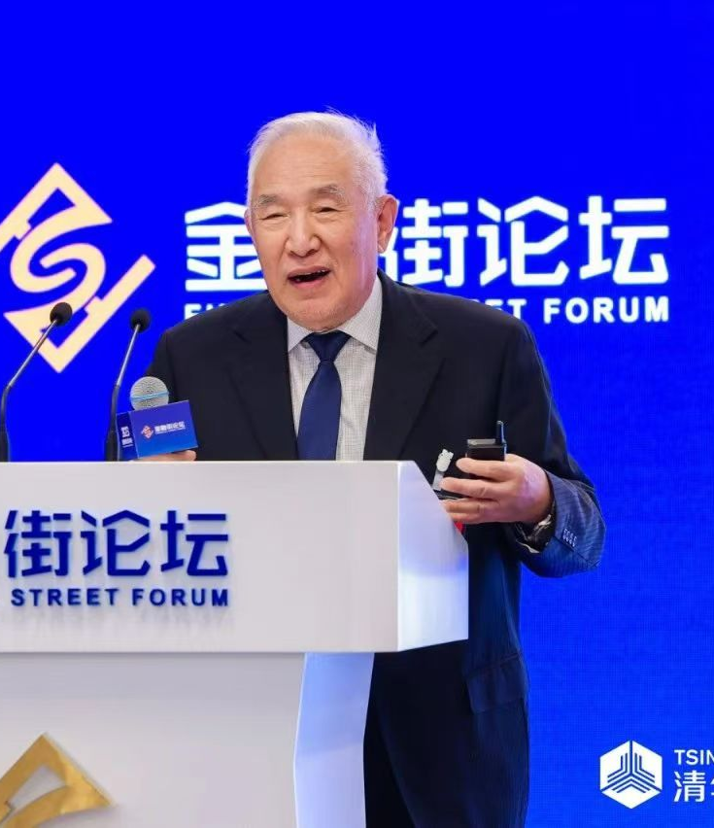
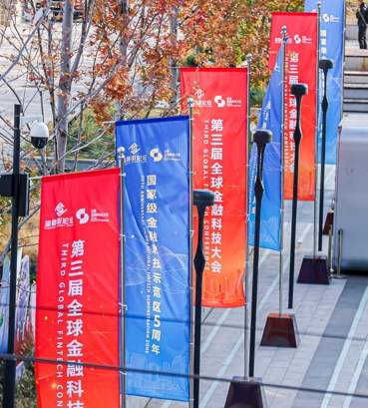
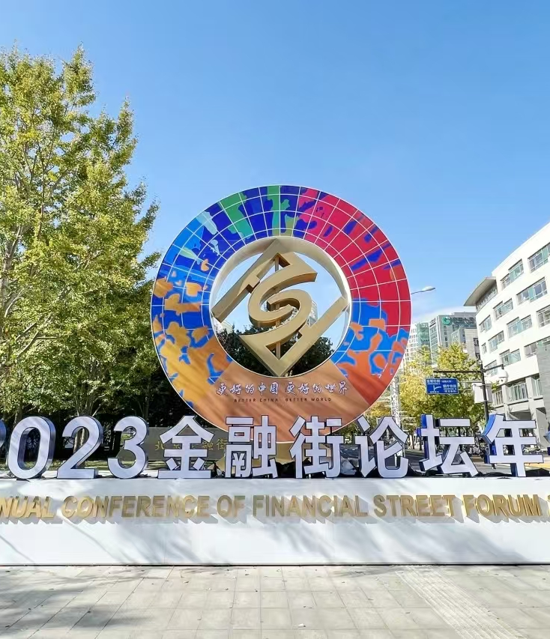
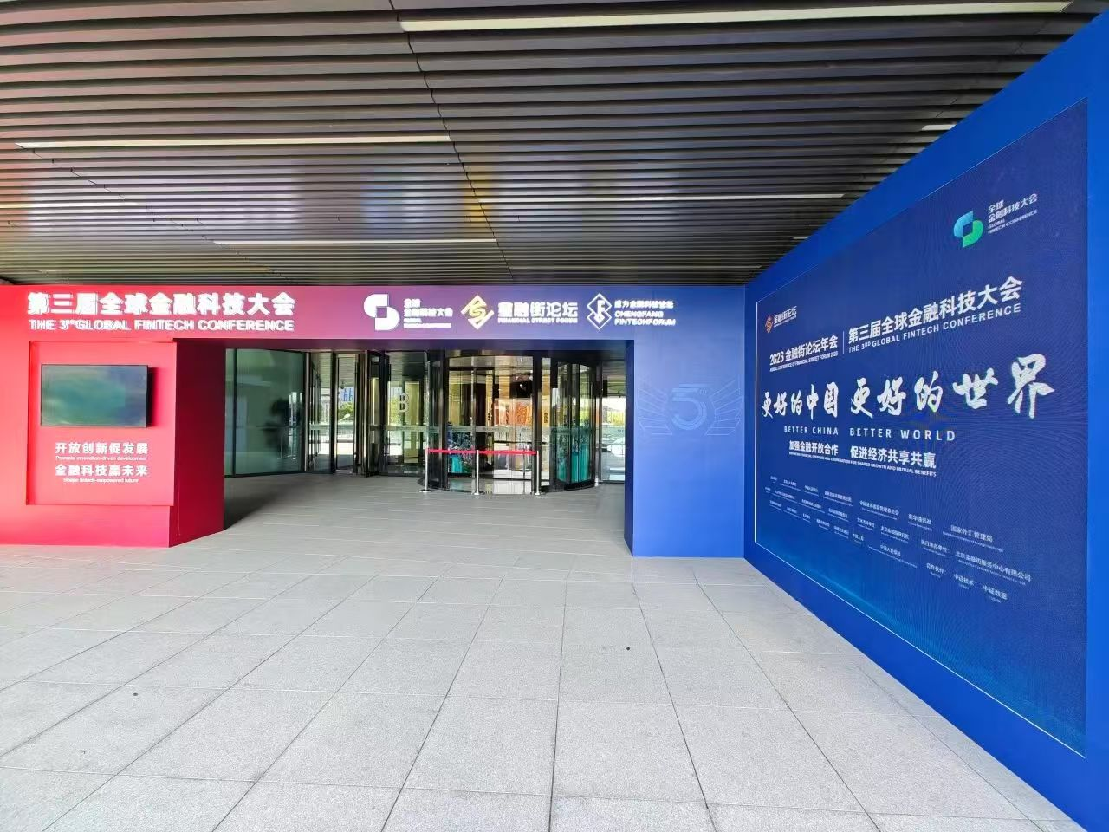
开放场景服务 Open scenario services
2024金融科技大会
The 2024 Global Fintech Conference
举办论坛、大赛等活动17场
17 events such as forums and competitions were held
来自18个国家和地区的，近256名重量级
嘉宾出席
256 high-profile guests from 16 countries and regions attended
对外发布19项重要成果，公布我国金融业唯一的部级科技奖项——金融科技发展奖
Announced 19 major achievements and unveiled Fin-Tech Development Award — the only ministerial-level science and technology award in Chinese financial sector
2025金融科技大会将于10月举办
The 2025 Global Fintech Conference will be held in October

Slide 15
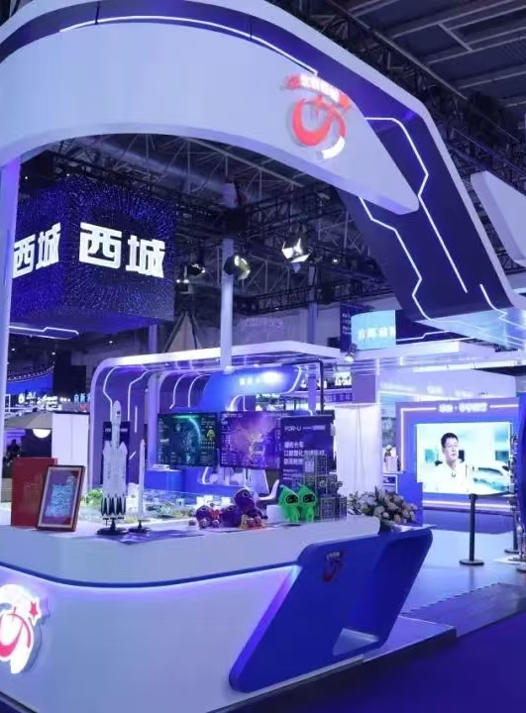
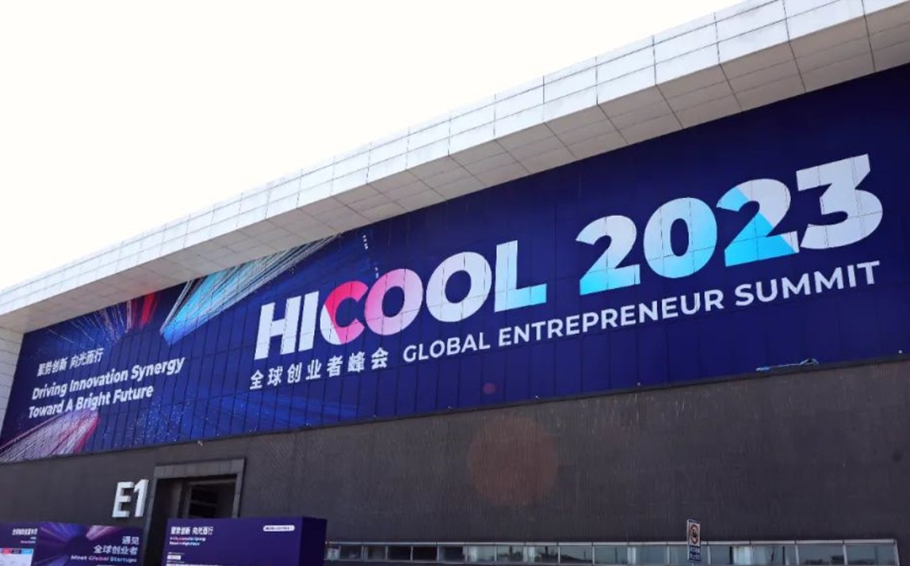
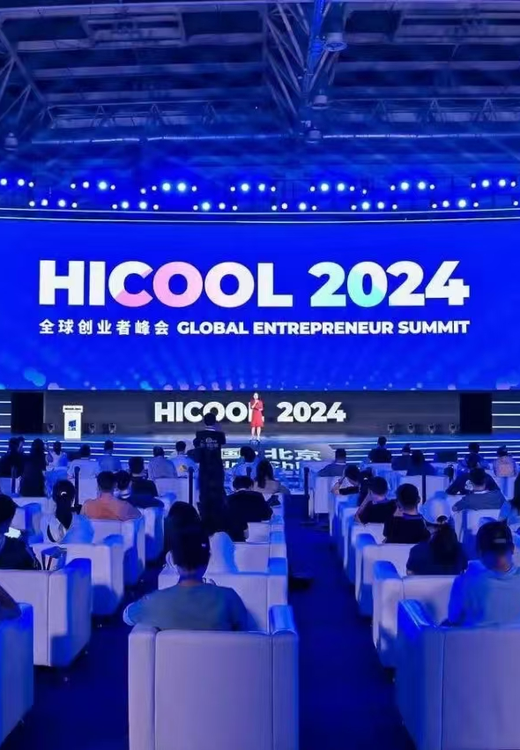
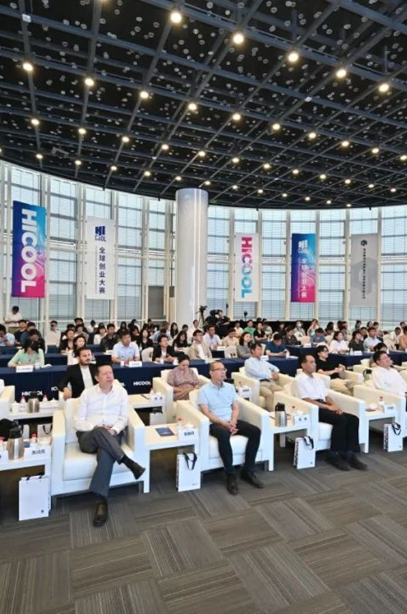
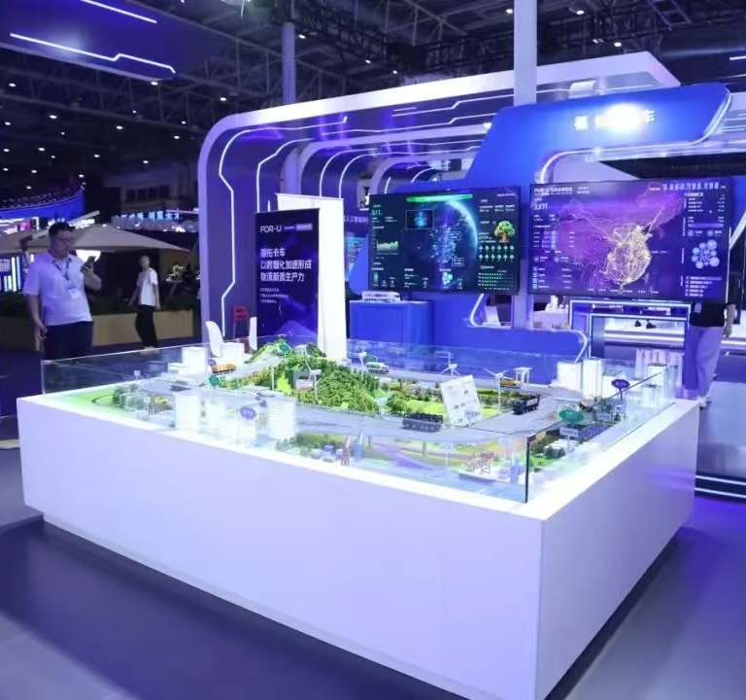
开放场景服务 Open scenario services
HICOOL全球创业者峰会持续举办
HICOOL Global Entrepreneur Summit Continues to Be Held
已成功举办四届
Four editions have been held
西城区承办金融科技赛道 （路演、展览、洽谈、交流）
The Xicheng District has been the venue for fintech events such as roadshows, exhibitions, discussions, and networking
2023年出台
《西城区HICOOL大赛人才及创业项目落地支持办法》
In 2023, it launched the Support Measures for Talent and Entrepreneurial Projects of the HICOOL Competition in Xicheng District

Slide 16

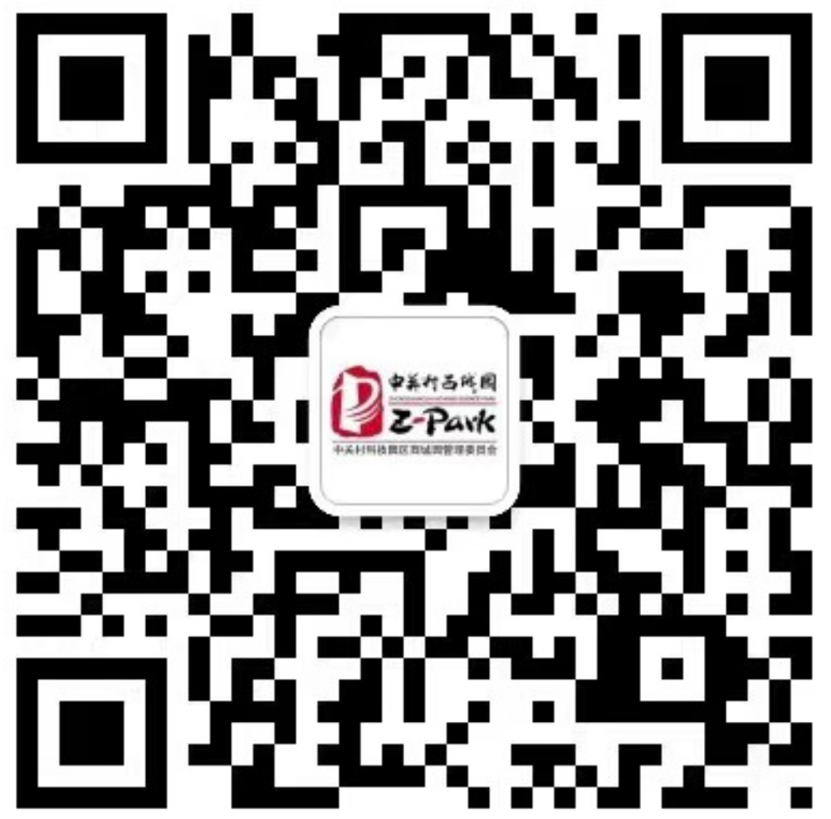
欢迎大家走进西城
来到西城园、金科新区投资兴业！
  Welcome to Xicheng District!
  Invest and thrive in the Xicheng Park and the Fin-Tech New Area!
中关村西城园微信公众号
Xicheng Park
WeChat Public Account

